Slide 1
Tutorial #7
October 29, 2013

Slide 2
Study #1
The objective of this study was to determine the effect of refeeding food-deprived rats on hepatic glucose-6-phosphatase (G6Pase) activity. Rats were food-deprived for 48hrs and then given free access to food for 0, 90, 180 or 360 minutes. At each time point, plasma was obtained for glucose and insulin measurements and liver samples removed for enzyme determination. In addition to G6Pase, paprnitrophenyl-phosphatase (PNPase) activity was monitored as a control for the G6Pase measurement.

Slide 3
To determine whether changes in glucose or insulin were mediating the effects of refeeding on hepatic G6Pase activity, a euglycemic, hyperinsulinemic clamp experiment was performed. Food-deprived rats were fitted with catheters in the carotid artery and jugular vein for blood sampling (artery) and glucose and insulin infusions (vein). Rats were perfused with predetermined doses of insulin and then variable doses of glucose were administered in order to maintain normal blood glucose levels. Fifty minutes after commencement of the infusion, liver samples were removed for G6Pase determination.

Slide 4
G6Pase
Glucose-6 phosphate
Glucose
Glycogenolysis

Slide 5
Experimental Design
Free access to food
Time 0
(food deprived rats)
90 mins
180 mins
360 mins
Measurements:
G6Pase activity
Glucose and insulin measurements
PNPase

Slide 6
Table 1. Changes in plasma glucose and insulin
levels in previously unfed rats in the course of refeeding
Refeeding time |  | Plasma glucose |  | Plasma insulin
min |  | mmol/L |  | pmol/L
0 |  | 6.3+/-0.6 |  | 83+/-14
90 |  | 11.1+/-0.7* |  | 366+/-54
180 |  | 10.1+/-1.1* |  | 331+/-56*
360 |  | 9.2+/-0.8* |  | 345+/-41*
Values are means +/- SEM. *p<0.05 vs time 0.

Slide 7
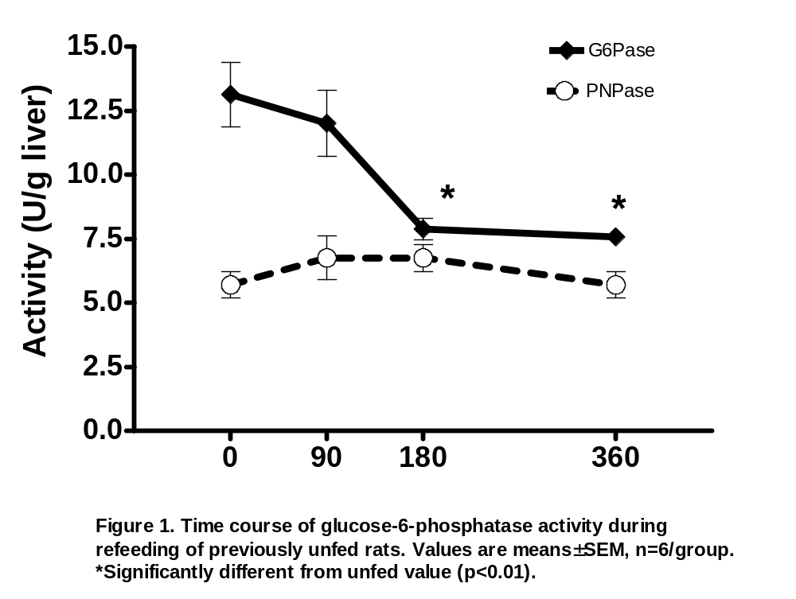

Slide 8
2. Using the data provided, discuss the relative contributions of hepatic and dietary carbohydrate to plasma glucose levels observed over the time course monitored (7).

Slide 9
G-6-Pase activity decreases significantly by 180 & 360 minutes, while blood glucose & insulin levels continue to rise during this time. We would expect this since a supply of glucose from the food reduces the amount that the body needs to supply endogenously from the liver
Illustrates the shift from the metabolic state seen in the post-absorptive or fasted state, to the metabolic state of a fed animal
PNPase is just a housekeeping enzyme.

Slide 10
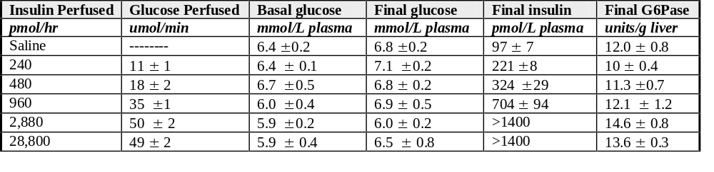
Euglycemic, hyperinsulinemic clamp
Table 2: Effect of insulin infusion on glucose-6-phosphatase activity in unfed rats with euglycemic clamps:
Values are means ± SEM (n=3-8 rats/group) Basal glucose was determined just prior to the infusion and final glucose and insulin was measured at the end of the perfusion period. For the G6Pase activity, ANOVA did not reveal any significant differencds (p>0.15)

Slide 11
Euglycemic, hyperinsulinemic clamp
Table 2: Effect of insulin infusion on glucose-6-phosphatase activity in unfed rats with euglycemic clamps:
Infuse a set amount of insulin into the animal’s vein

Slide 12
Euglycemic, hyperinsulinemic clamp
Table 2: Effect of insulin infusion on glucose-6-phosphatase activity in unfed rats with euglycemic clamps:
2) Infuse glucose into the same vein and adjust the amount of glucose infused to keep blood glucose at normal levels (~5mM)

Slide 13
Euglycemic, hyperinsulinemic clamp
Table 2: Effect of insulin infusion on glucose-6-phosphatase activity in unfed rats with euglycemic clamps:
3) Measure how much glucose had to be infused to keep blood glucose normal

Slide 14
Euglycemic, hyperinsulinemic clamp
Table 2: Effect of insulin infusion on glucose-6-phosphatase activity in unfed rats with euglycemic clamps:
*By design, blood glucose doesn’t change in the animal but blood insulin levels are very high.

Slide 15
Euglycemic, hyperinsulinemic clamp
Clamp is often used in studies examining insulin resistance and/or type 2 diabetes
Insulin Resistance: less glucose needed to be infused to maintain normal blood level because less effective cellular uptake of glucose

Slide 16
Question 4: Discuss whether G6Pase activity is predominantly regulated by dietary carbohydrate or hormonal factors.
Re-feeding experiment showed that dietary carbohydrate increased both glucose and insulin (Table 1) and there was a resulting drop in G6Pase activity (PNPase)
  Could be either glucose or insulin
Clamp experiment showed that when only the hormonal factor (i.e. insulin) was altered and not blood glucose there was no change in G6Pase activity
Integrating the 2 experiments together suggests that the drop in G6Pase observed in study 1 is likely due to changes in blood glucose.

Slide 17
Study 2
The purpose of this experiment was to determine the effects of dietary restriction and subsequent weight loss on phosphofructokinase-I (PFK-I) activity in selected skeletal and heart muscles. Fifty-five female rats were separated into 3 groups for 10 weeks of dietary restriction. 1) AL = ad libitum fed (no restriction), 2) MR = moderate restriction (weight reduced to 81% of AL) and 3) SR = severe restriction (weight reduced to 63% of AL). During the last week of the study, a measurement of the animal’s resting oxygen uptake was taken in order to estimate total oxygen consumption associated with energy metabolism. The rats were then killed and the PFK-1 activity in the heart and various skeletal muscles was determined using standardized techniques.

Slide 18
Study design
55 Female Rats
Ad Libitum
Moderate
Restriction
Severe
Restriction
-Resting oxygen uptake (total oxygen consumption associated with energy metabolism)
-PFK-1 activity in the heart and various skeletal muscles

Slide 19
PFK-1
Fructose-1,6 bisphosphate
Fructose-6 phosphate
Glycolysis

Slide 20
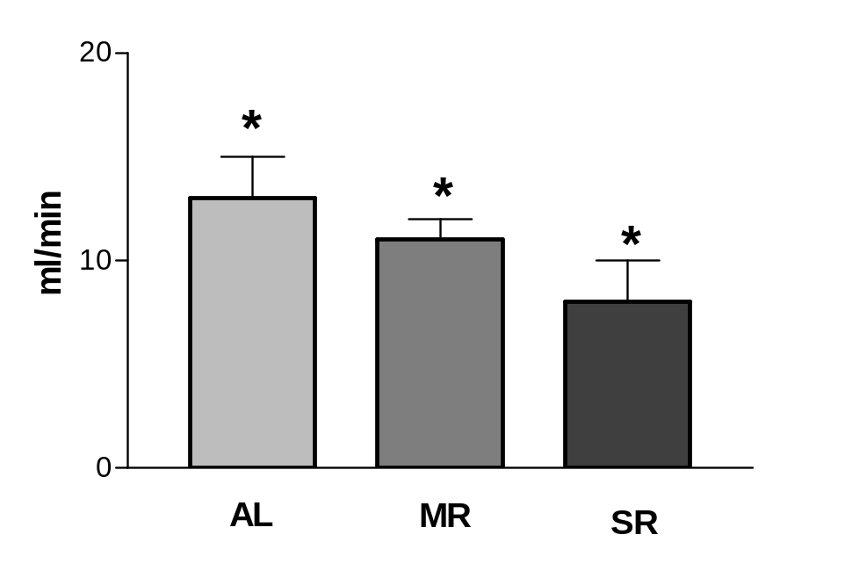
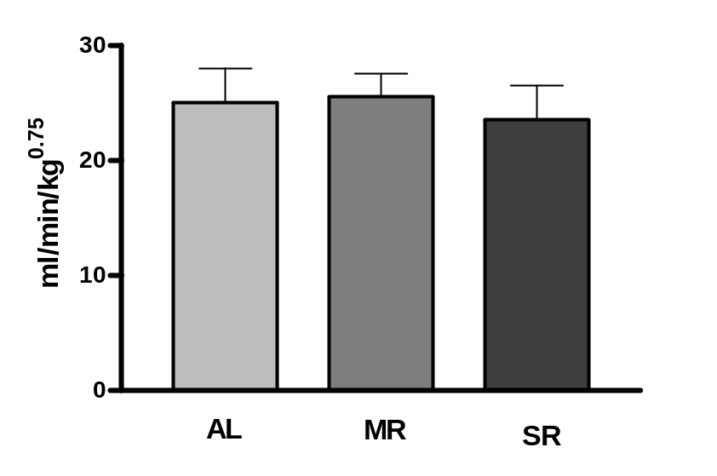
Figure 1. Resting oxygen uptake for 55 female Sprague-Dawley rats expressed
in absolute (ml/min) and relative (ml/min/kg^{0.75}) terms. *All groups are statistically different from each other, p<0.05.

Slide 21
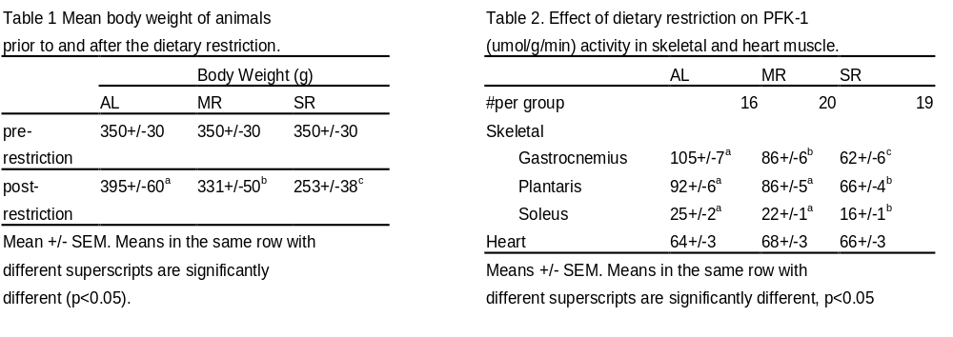

Slide 22
Question 2: Discuss a mechanism to explain the effects of dietary restriction on substrate utilization in skeletal muscle.
Caloric restriction causes a drop in body weight (more severe restriction = greater body weight drop) (Table 1)
Calorically restricted rats have decreased metabolism (resting O2 uptake) but this is totally accounted for by the loss in body weight (Figure 1)
  There is no significant difference between groups when data normalized for body weight

Slide 23
Question 2: Discuss a mechanism to explain the effects of dietary restriction on substrate utilization in skeletal muscle.
Skeletal muscle PFK-1 activity drops with caloric restriction (but not heart muscle PFK-1) (Table 2)
Total oxidative activity hasn’t changed (figure 1) but glycolysis is decreased (indicated by ↓ PFK-1)
↓ energy intake leads to ↓ PFK-1 activity and thus ↓ glucose use
Restricted animals are most likely mobilizing fat from adipose tissue and some protein for fuel

Slide 24
Question3: What other enzyme/metabolites would you want to measure to verify the PFK-1 enzyme effect, and why?
Any enzymes/metabolites in glycolytic pathway
Any enzymes/metabolites in beta-oxidation to confirm increased use of fat for fuel

